Slide 1

Mohamed Hamdy
Android Developer

Slide 2
Animation in Android
SharedElementTransition
ViewProperty
Animator
MotionLayout

Slide 3
Shared Element Transition

Slide 4
Need To Start
Transition Name
Shared Element
Activity Options
Transition Set (Optional)

Slide 5
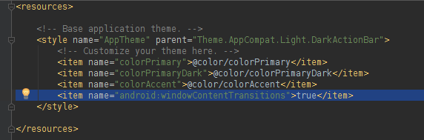
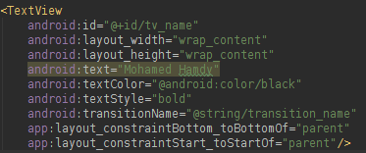
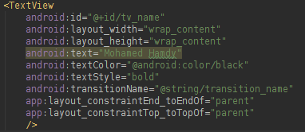
First activity
Second activity

Slide 6


Slide 7
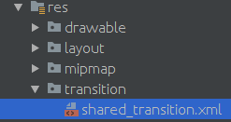
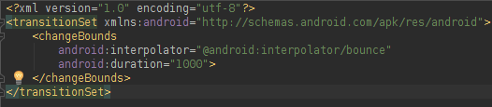

What If I need more smooth, natural, good looking and accelerated animations ?
Interpolators for the rescue

Slide 9
Animator
ObjectAnimator
ValueAnimator
AnimatorSet

Slide 10
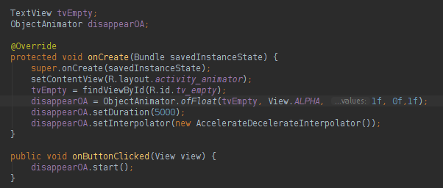
ObjectAnimator

Slide 11
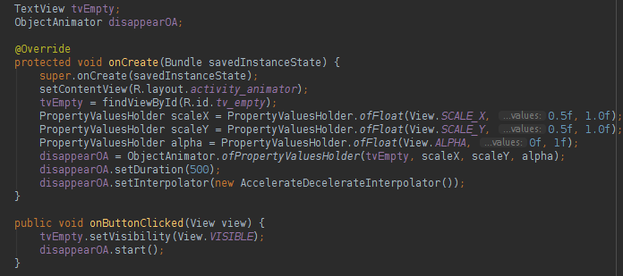
PropertyValuesHolder

Slide 12

AnimatorSet

Slide 13
There Is a problem with that, let’s figure it out

Slide 14
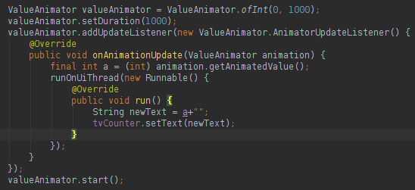
ValueAnimator

Slide 15

ViewPropertyAnimation

Slide 16

MotionLayout

Slide 18
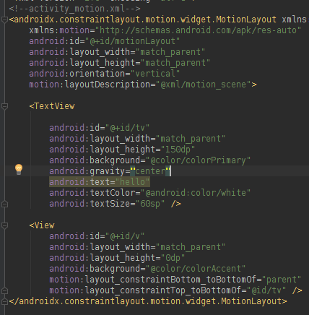
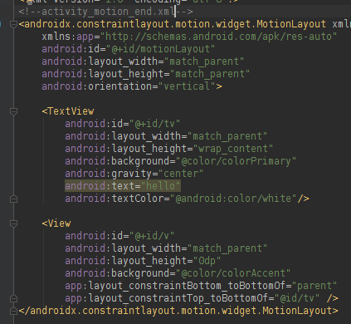
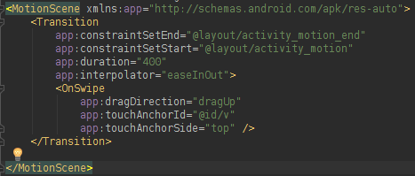


Slide 20
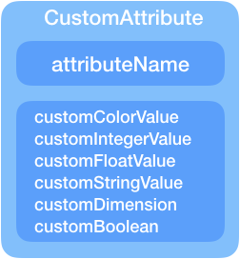
Here Comes the CustomAttributes

Slide 21
Now :

Slide 22
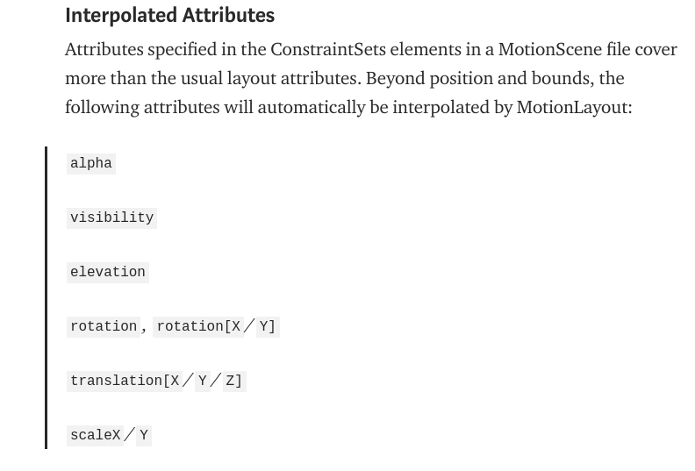

Slide 23
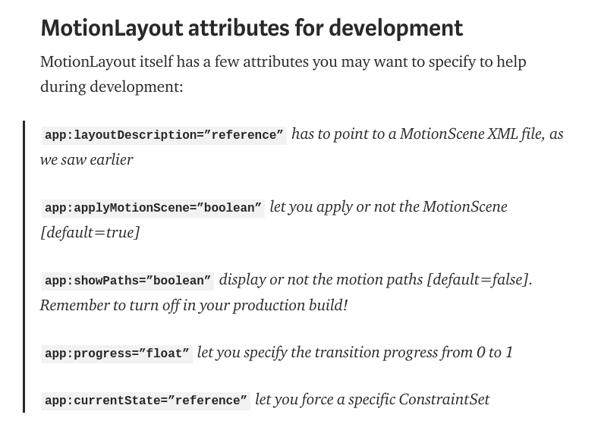

Slide 24
Sources are attached in the repository on GitHub

Slide 25


https://www.youtube.com/channel/UCF4TwNcuxvPaIXPyzV_RyZg
https://github.com/IMoHaMeDHaMdYI/AnimationStation

